Slide 1
How to Guide: GNPD
Best practices in searching and analyzing data in Mintel's Global New Products Database. Step by step explanations with images and concise video links are included.
Read on mintel.com
Notes:
© 2020 Mintel Group Ltd. All Rights Reserved. Confidential to Mintel.

Slide 2
Table Of Contents
1
INTRODUCTION
2
HOW TO SEARCH
3
HOW TO ANALYZE AND INTERPRET DATA
4
YOUR MINTEL TEAM

Slide 3
Before getting started
It is strongly suggested you are logged onto Mintel's Homepage and follow along with this report
This is a guide to help get you started. If you want a tailored training or help with a search, please reach out to your Mintel team
There are links at the bottom of each slide for you to directly reference content
Read on mintel.com
Notes:
© 2020 Mintel Group Ltd. All Rights Reserved. Confidential to Mintel.

Slide 4
Introduction
What is GNPD and what can I learn from using this tool?
Read on mintel.com
Notes:
© 2020 Mintel Group Ltd. All Rights Reserved. Confidential to Mintel.

Slide 5
Global New Products Database Explained
Mintel tracks over 40,000 products in 86 countries with the help of specially trained mystery shoppers. GNPD can be used to analyze trends over time, or launch activity by competitor by answering questions such as, "what claims are growing in skincare in South Korea?" or "what ingredients are competitors using in their cosmetic innovations?"
Read on mintel.com
Notes:
© 2020 Mintel Group Ltd. All Rights Reserved. Confidential to Mintel.

Slide 6
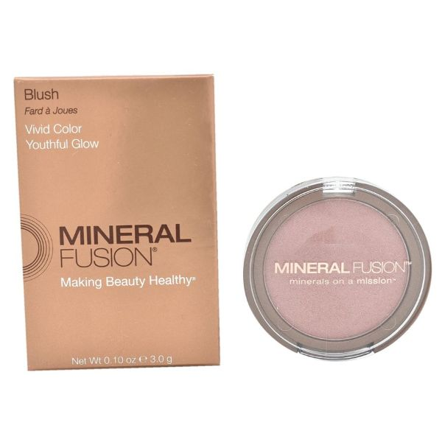
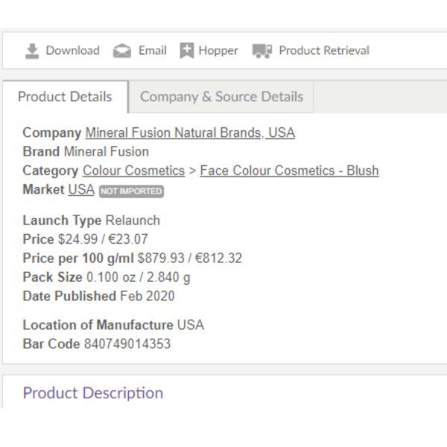
Example of a Product Record
Click on the link below the product image to see product information captured.
Product data that is captured is easily filterable using GNPD's advanced search function.
GNPD's analyze function enables you to quickly view trends based on the product data captured.
Mineral Fusion's Blush
Product details are filterable (ie company, market, price and more)
Source: Mintel GNPD
Read on mintel.com
Notes:
Source: Mintel GNPD
© 2020 Mintel Group Ltd. All Rights Reserved. Confidential to Mintel.

Slide 7
How to search
Read on mintel.com
Notes:
© 2020 Mintel Group Ltd. All Rights Reserved. Confidential to Mintel.

Slide 8
Advanced search
To search for specific product innovations by market, sub-category, brands and more
Read on mintel.com
Notes:
© 2020 Mintel Group Ltd. All Rights Reserved. Confidential to Mintel.

Slide 9
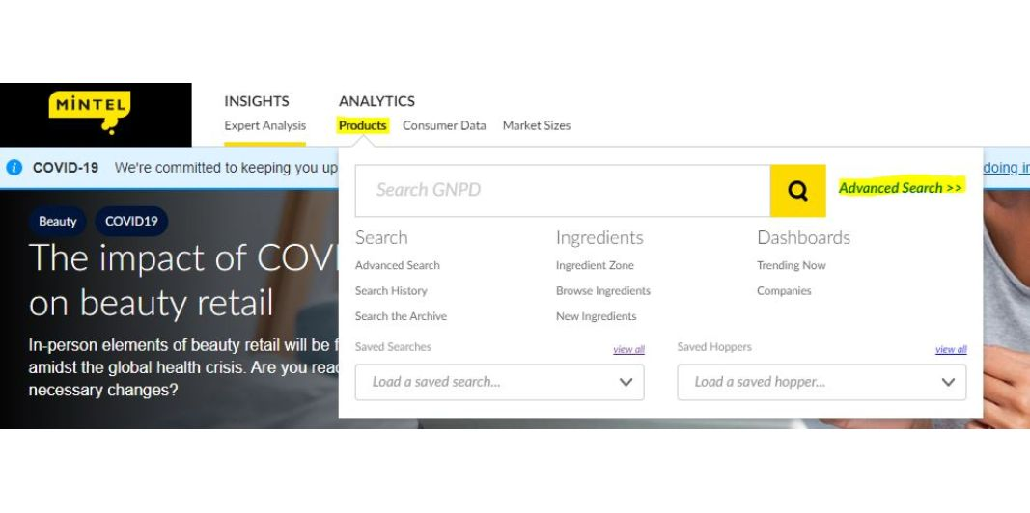
Where is the Advanced Search?
On your Mintel homepage, hover over "Products" and click "Advanced Search" to create a tailored search of product innovations.
Source: Mintel Homepage
Read on mintel.com
Notes:
Source: Mintel Homepage [1]
[1] https://clients.mintel.com/
© 2020 Mintel Group Ltd. All Rights Reserved. Confidential to Mintel.

Slide 10
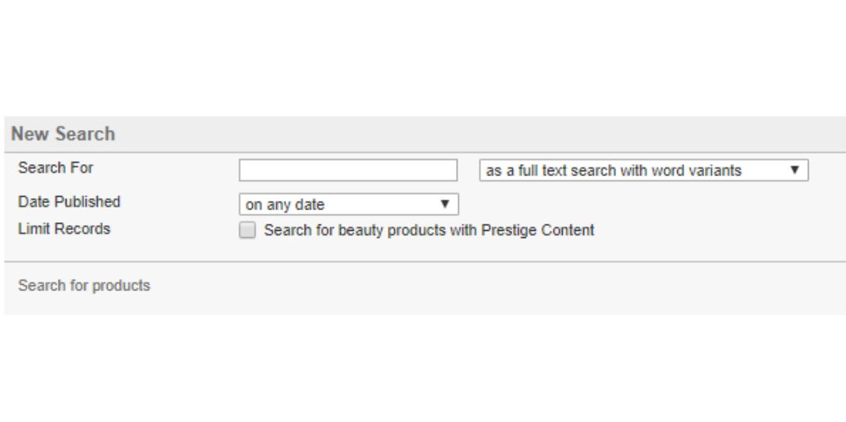
Filter: Date Published and Text Search Box
"Search For" text box - used to find keywords. Adjust the filter option using the drop down "as a full text.." to search keywords in the brand name, product description and more.
Date Published - use the drop down to look at products from a specific time period.
Source: Mintel GNPD Advanced Search
Read on mintel.com
Notes:
Source: Mintel GNPD Advanced Search [1]
[1] https://www.gnpd.com/sinatra/gnpd/search/
© 2020 Mintel Group Ltd. All Rights Reserved. Confidential to Mintel.

Slide 11
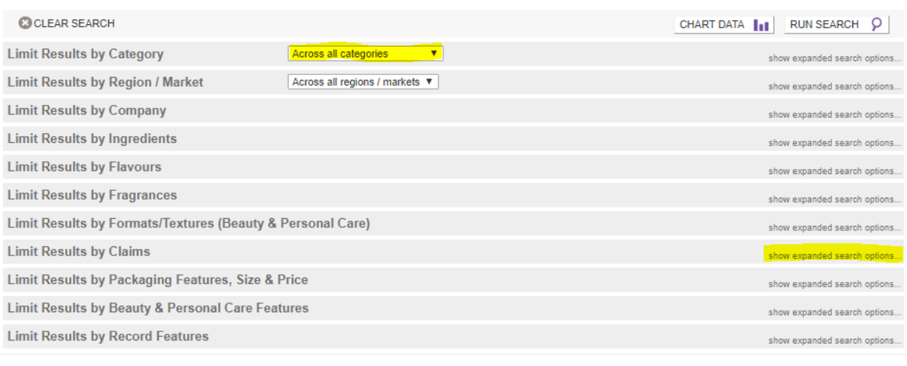
Filter: Category, Market, Packaging, etc
Click "show expanded search options" on the right hand side to select specific filter options.
Source: Mintel GNPD Advanced Search
Read on mintel.com
Notes:
Source: Mintel GNPD Advanced Search [1]
[1] https://www.gnpd.com/sinatra/gnpd/search/
© 2020 Mintel Group Ltd. All Rights Reserved. Confidential to Mintel.

Slide 12
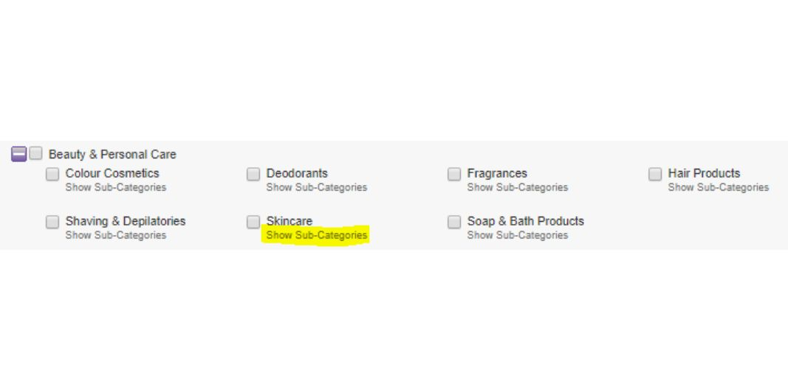
Filter: Category, Ingredient, Claim, etc
Click "showexpanded search options" to hand select specific filter options.
Click on boxes next to Categories of interest - Super Category (ie Beauty & Personal Care) or Category (ie Color Cosmetics, Skincare)
Click "Show Sub-Categories" to further filter products (example: Face Color-Primer is a Sub-Category in Color Cosmetics).
Source: Mintel GNPD Advanced Search
Read on mintel.com
Notes:
Source: Mintel GNPD Advanced Search [1]
[1] https://www.gnpd.com/sinatra/gnpd/search/
© 2020 Mintel Group Ltd. All Rights Reserved. Confidential to Mintel.

Slide 13
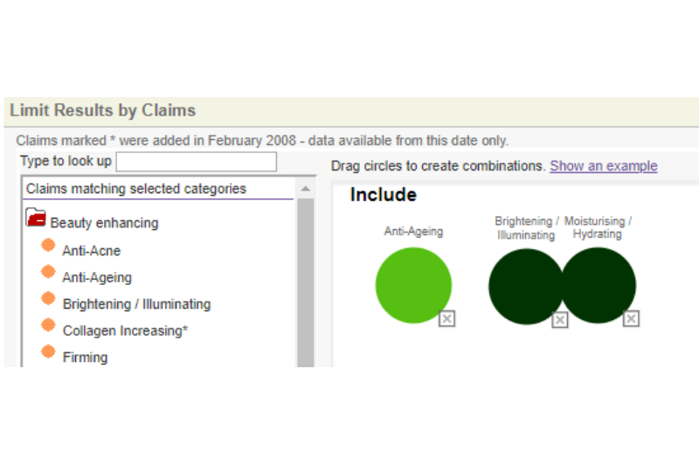
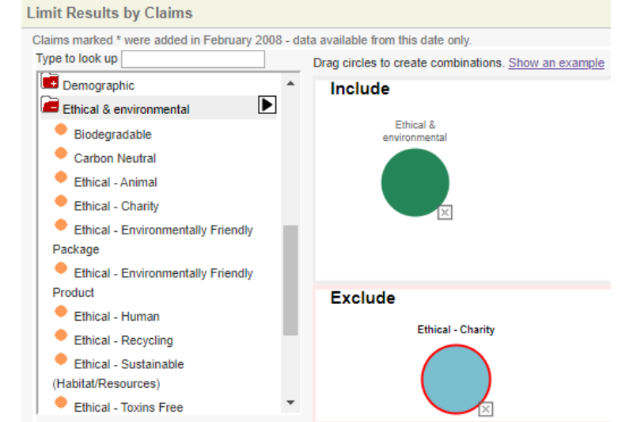
Filter Functionality: Company-Claim
When referencing the Advance Search page, the Company-Claims sections function similarly.
Look for products with a specific claim OR products with multiple claims combined (same color)
Look for products with claims while excluding specific claims that are not relevant
Source: Mintel GNPD Advanced Search﻿
Read on mintel.com
Notes:
Source: Mintel GNPD Advanced Search﻿ [1]
[1] https://www.gnpd.com/sinatra/gnpd/search/
© 2020 Mintel Group Ltd. All Rights Reserved. Confidential to Mintel.

Slide 14
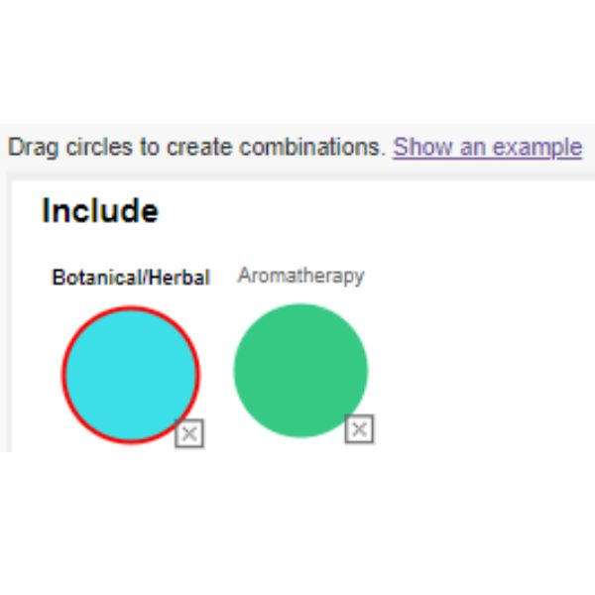
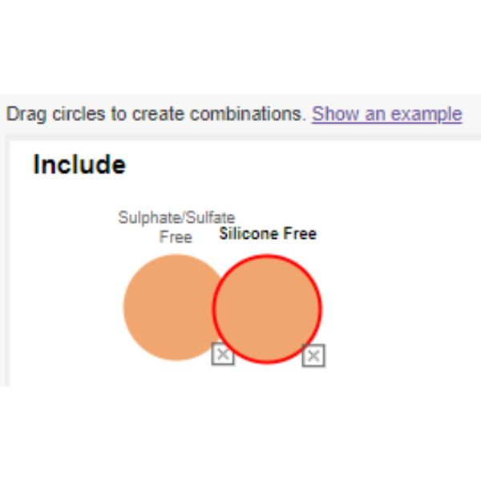
Filter Functionality: Company-Claim Explained
Add claims into the filter options, then drag claims into the include or exclude boxes.
If claims are in the same box but NOT the same color, you are using an either/or function (ie the product has at least one of the claims selected on pack). See left image.
If claims are in the same box, AND are the same color (done by dragging the circle on top of the other), then you are searching for products that have BOTH claims on pack. See right image.
Products that have EITHER Botanical/Herbal or Aromatherapy claims
Products that have BOTH Sulfate Free AND Silicone Free Claims
Source: Mintel GNPD Advanced Search﻿
Read on mintel.com
Notes:
Source: Mintel GNPD Advanced Search﻿ [1]
[1] https://www.gnpd.com/sinatra/gnpd/search/
© 2020 Mintel Group Ltd. All Rights Reserved. Confidential to Mintel.

Slide 15
Saved Searches
Reference past searches and saved searches
Read on mintel.com
Notes:
© 2020 Mintel Group Ltd. All Rights Reserved. Confidential to Mintel.

Slide 16
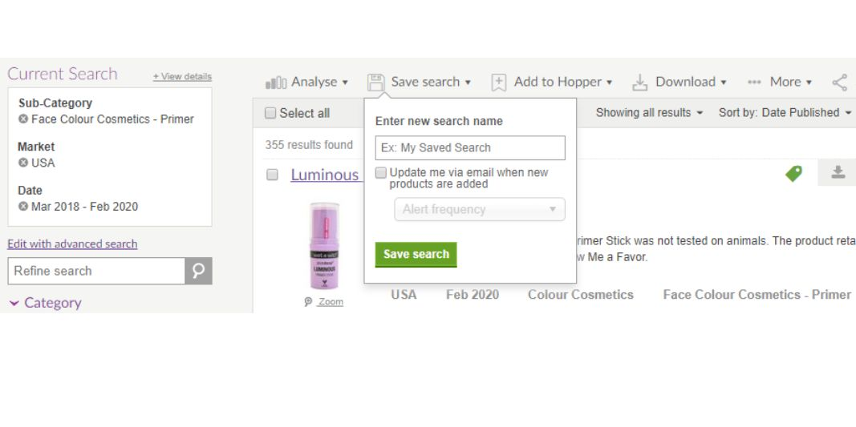
Saving a Search and Email Alerts
After clicking "Run Search" from the Advanced Search page, you will land on the results page (see left).
You can save a search to quickly reference later and also set up email alerts.
Email Alerts - open the date by scrolling down and clicking "current date" check box on the left hand side, hit "Run Search". Then save the search and set up daily/monthly alerts by clicking "update me via email.."
Base: 355 results found
Source: Mintel GNPD Search Page﻿
Read on mintel.com
Notes:
Source: Mintel GNPD Search Page﻿ [1]
[1] https://www.gnpd.com/sinatra/shared_link/b32122a1-b73f-4a6c-bf70-f52402178525
© 2020 Mintel Group Ltd. All Rights Reserved. Confidential to Mintel.

Slide 17
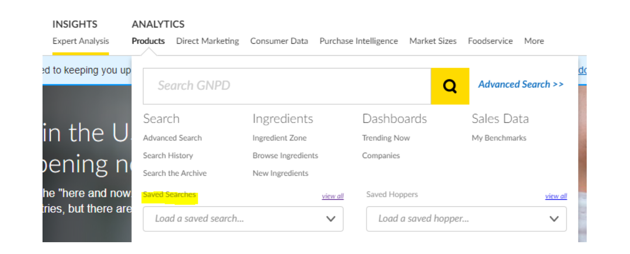
Accessing Saved Searches
At the top of the page, hover over "Products" to see Saved Searches.
There is a "View All" link to the right to help manage saved searches.
Source: Mintel Homepage
Read on mintel.com
Notes:
Source: Mintel Homepage [1]
[1] https://clients.mintel.com/
© 2020 Mintel Group Ltd. All Rights Reserved. Confidential to Mintel.

Slide 18
Ingredient Zone
To view pre-created ingredient trends by market and sub-category
Read on mintel.com
Notes:
© 2020 Mintel Group Ltd. All Rights Reserved. Confidential to Mintel.

Slide 19
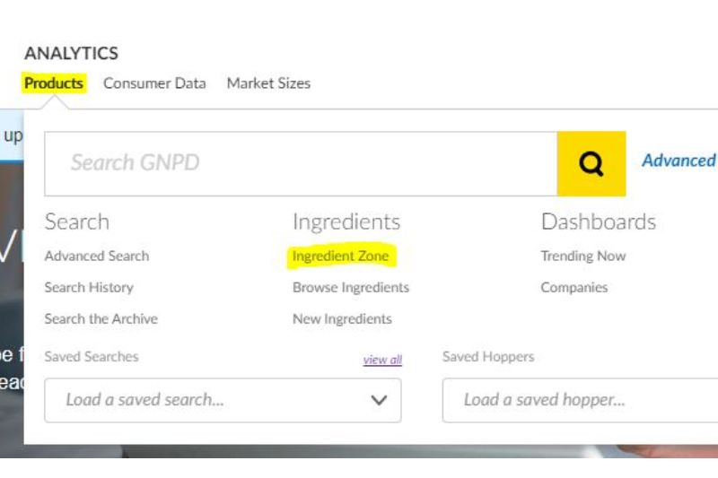
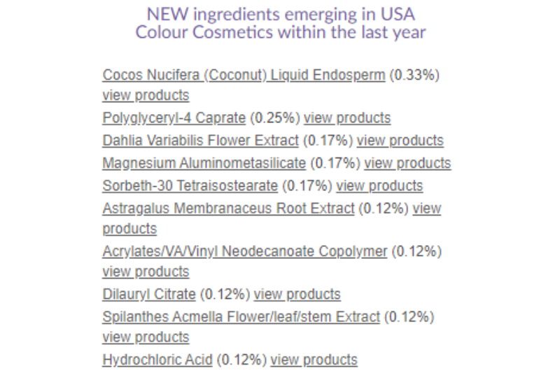
Ingredient Zone
See fastest growing ingredients, emerging ingredients and most common ingredients quickly.
Where to find the Ingredient Zone?
Example of information available
Source: ﻿Mintel Ingredient Zone
Read on mintel.com
Notes:
Source: ﻿Mintel Ingredient Zone [1]
[1] https://www.gnpd.com/sinatra/ingredients/
© 2020 Mintel Group Ltd. All Rights Reserved. Confidential to Mintel.

Slide 20
How to analyze and interpret data
Read on mintel.com
Notes:
© 2020 Mintel Group Ltd. All Rights Reserved. Confidential to Mintel.

Slide 21
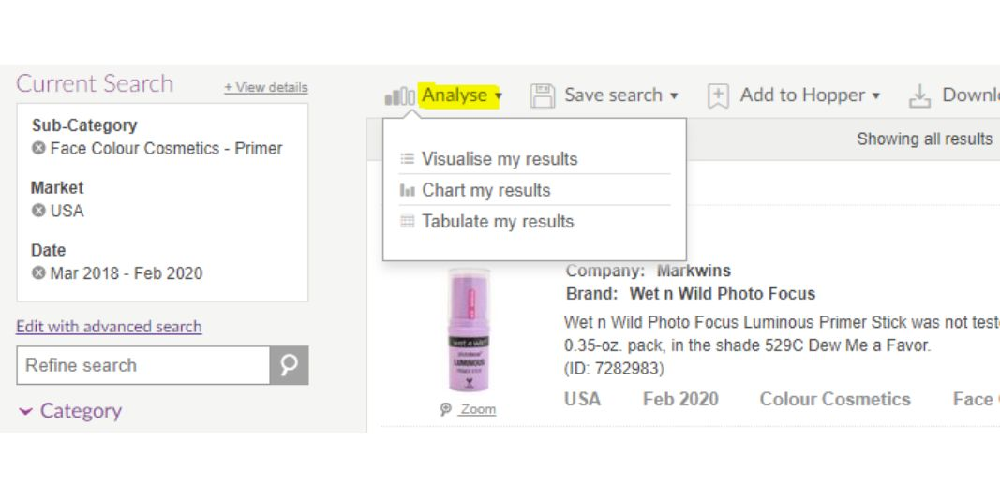
Where to find the Analyze Function
After clicking "Run Search" from the Advanced Search page, you will land on the results page (see left).
Visualize my results - high level, pre-made insights based on product results found.
Chart my results - create your own analysis over time, by competitor, etc.
Tabulate my results - create your own analysis using pivot tables. Great for price and ingredient analyses.
Base: 355 results found
Source: ﻿Mintel GNPD Search Page
Read on mintel.com
Notes:
Source: ﻿Mintel GNPD Search Page [1]
[1] https://www.gnpd.com/sinatra/shared_link/b32122a1-b73f-4a6c-bf70-f52402178525
© 2020 Mintel Group Ltd. All Rights Reserved. Confidential to Mintel.

Slide 22
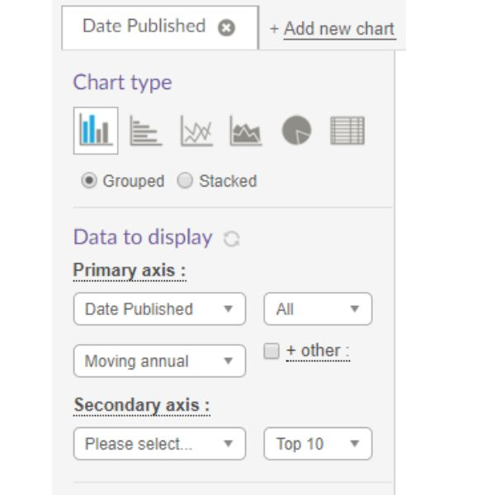
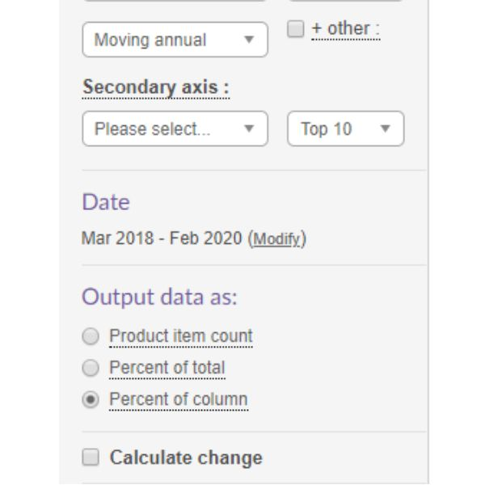
Chart My Results - Analysis Page
Primary and secondary axis can be edited to analyze any information within GNPD's filter options (ie date published, brand, textures, etc.)
Output data - suggest analyzing by percentages due to multiple variants captured in one product record, which affects the understanding of product item count (ie the same lipstick offered in 10+ shades is 1 product with 10+ variants)
Calculate Change - used to see growing and declining trends over time.
Base: 355 results found
Source: ﻿Mintel GNPD Analysis
Read on mintel.com
Notes:
Source: ﻿Mintel GNPD Analysis [1]
[1] https://www.gnpd.com/sinatra/shared_link/02338538-0b45-4a5f-ae65-35be299be3da
© 2020 Mintel Group Ltd. All Rights Reserved. Confidential to Mintel.

Slide 23
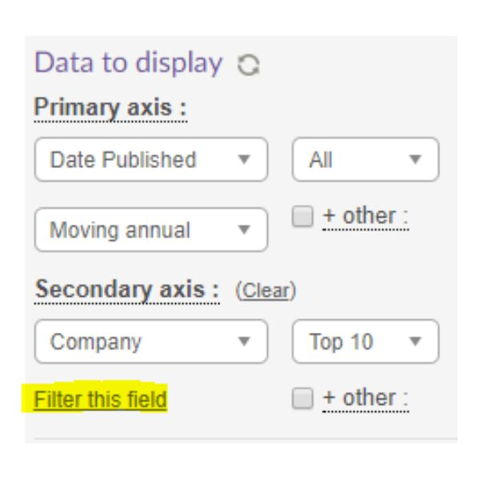
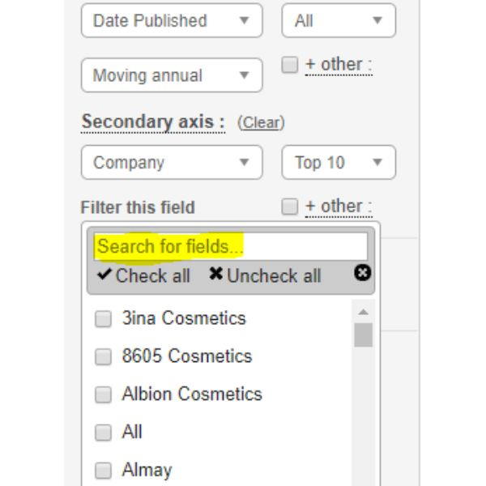
Filter Information Further with "Filter this Field"
After selecting axis's, you can use the "Filter this Field" link to hone in on specific companies, claims, ingredients, etc. in your analysis.
There is a free text search option labelled "Search for Fields.." or you can scroll through the list of options and check what's most applicable.
Base: 355 results found
Source: ﻿Mintel GNPD Analysis
Read on mintel.com
Notes:
Source: ﻿Mintel GNPD Analysis [1]
[1] https://www.gnpd.com/sinatra/shared_link/22670ce7-7f71-443c-be91-2425a335cdbd
© 2020 Mintel Group Ltd. All Rights Reserved. Confidential to Mintel.

Slide 24
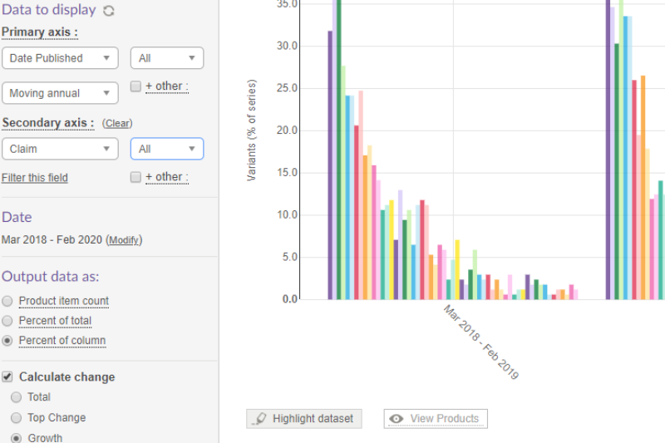
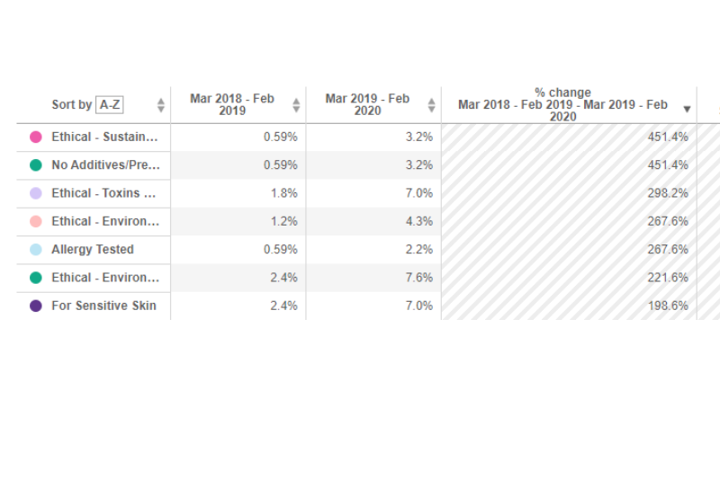
Interpreting the Data - Top Growing Claims in US Primer Innovations
In the last 12 months, Ethical - Sustainable (Habitat/Resource) and No Additives/Preservative claims grew ~450% in US primer innovations. Reference the link below.
Base: 355 results found
Source: ﻿Mintel GNPD Analysis
Read on mintel.com
Notes:
Source: ﻿Mintel GNPD Analysis [1]
[1] https://www.gnpd.com/sinatra/shared_link/22670ce7-7f71-443c-be91-2425a335cdbd
© 2020 Mintel Group Ltd. All Rights Reserved. Confidential to Mintel.

Slide 25
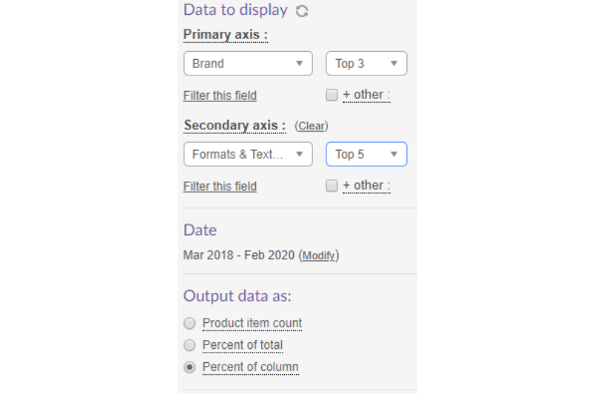
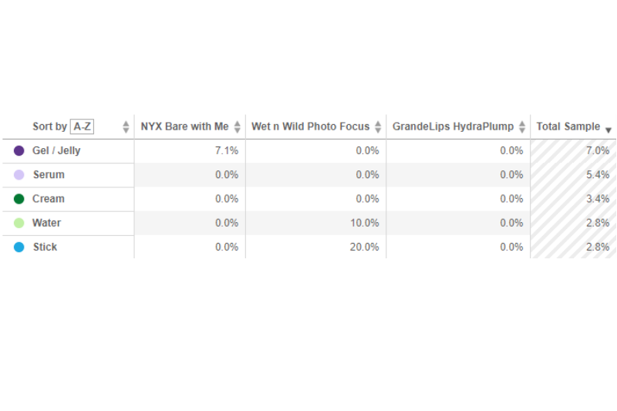
Interpreting the Data - Most Active Brands by Most Active Formats in US Primer Innovations
Of all Wet n Wild Photo Focus US primer innovations, 10% were in water format.
Reference Total Sample: of ALL the US primer innovations captured, 7% were in gel/jelly format.
Base: 355 results found
Source: ﻿Mintel GNPD Analysis
Read on mintel.com
Notes:
Source: ﻿Mintel GNPD Analysis [1]
[1] https://www.gnpd.com/sinatra/shared_link/7ce80bef-0ca4-480b-ae52-111ab5c5d818
© 2020 Mintel Group Ltd. All Rights Reserved. Confidential to Mintel.

Slide 26
Training Videos
The basics
Explore key category insights and product launches
Search for ingredient usage trends and create a prospect list
Monitor new launches, competitors or prospects
Save, share and download searches and set email alerts
Advanced search filters
Free text, date, categories, markets and companies
Ingredients and nutrition
Flavours and fragrances
Textures
Claims
Pack features, launch and storage types
Analysis and advanced features
Advanced ingredients search and analysis
Customise your Excel download columns
Analyse launch trends with the charting tool
﻿Advanced analysis with the tabulate tool
Sales data and benchmarks for top sellers
See the GNPD User Guide for further explanation of features.
Read on mintel.com
Notes:
Find definitions in the full ﻿Glossary of Mintel GNPD terms and explanations of analysis options in ﻿GNPD Analysis Fields.
© 2020 Mintel Group Ltd. All Rights Reserved. Confidential to Mintel.

Slide 27
your mintel team
Read on mintel.com
Notes:
© 2020 Mintel Group Ltd. All Rights Reserved. Confidential to Mintel.

Slide 28
Get in touch
Your team at Mintel is available to further walk through GNPD along with other Mintel solutions.
We're happy to set up email alerts, present Mintel content, retrieve innovative products and more.
Melody Jiang Account Manager, Academic mjiang@mintel.com
Read on mintel.com
Notes:
© 2020 Mintel Group Ltd. All Rights Reserved. Confidential to Mintel.

